Slide 1
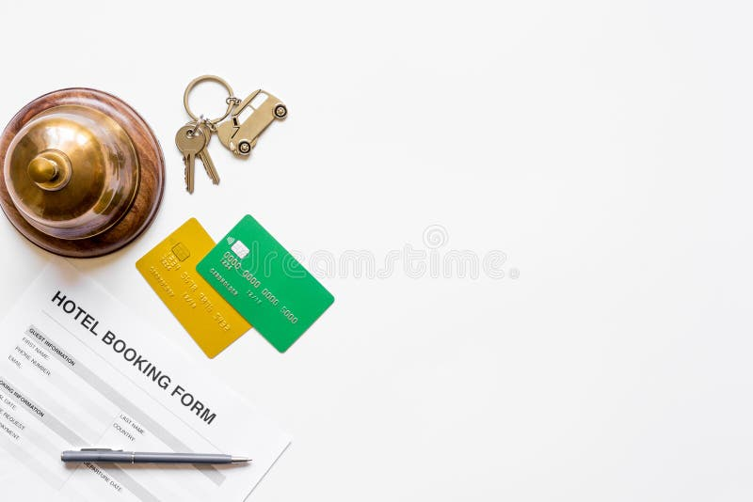
Prediction of Hotel
Reservation
– Preeti Vishwakarma

Slide 2
Table of content
Introduction
Reason
Objective
Work Flow
Tools and Algorithms used for project
Data Description
Data Preprocessing
Data Visualization
Data Partition
Model Train and Test Accuracy
Deployment
Challenges in the Project
Advantages
Application
Conclusion

Slide 3
Introduction
The word reservation is commonly known as blocking a specific room category for the guest for a particular period of time. So hotel needs to make sure a safe, assured and secure place for a guest stay who visits the hotel.
Usually, most of the guests prefer to make advance reservations in hotels, resorts or other kinds of accommodation.
The reservation is this bilateral commitment between a hotel and a guest, as stated by which the hotel should provide the particular room category which guest has been requested on booking and the guest have to concur to pay all pertinent charges. Generally, It is also known as a confirmation letter for the reservation.

Slide 4

objective
“ To analyse various factors leading to cancelation of reservations and also predict which customer will be profitable for the Hotel”

Slide 5
Process flow
Searching period
Reading research paper
Data Collection
Data cleaning
Data pre-processing
Data visualisation
Analysis and conclusion
Applying machine learning algorithm
Conclusion and Suggestions

Slide 6



TOOLS AND PLATFORM USED
Tools : Python, Tableau , Power BI
Platform : Jupiter Notebook
Library Used : Scikit-learn

Slide 7
Challenges
The available dataset was disorganized, with unclear column definitions, and I also had to remove several unnecessary columns.

Slide 8
Dataset Description
Columns | Description
Booking_ID | unique identifier of each booking
no_of_adults | Number of adults
no_of_children | Number of Children
no_of_weekend_nights | Number of weekend nights (Saturday or Sunday) the guest stayed or booked to stay at the hotel
no_of_week_nights | Number of week nights (Monday to Friday) the guest stayed or booked to stay at the hotel
type_of_meal_plan | Type of meal plan booked by the customer:

Slide 9
Columns | Description
required_car_parking_space | Does the customer require a car parking space? (0 - No, 1- Yes)
room_type_reserved | Type of room reserved by the customer. The values are ciphered (encoded) by INN Hotels.
lead_time | Number of days between the date of booking and the arrival date
arrival_year | Year of arrival date
arrival_month | Month of arrival date
arrival_date | Date of the month

Slide 10
Column | Description
market_segment_type | Market segment designation.
repeated_guest | Is the customer a repeated guest? (0 - No, 1- Yes)
no_of_previous_cancellations | Number of previous bookings that were canceled by the customer prior to the current booking
no_of_previous_bookings_not_canceled | Number of previous bookings not canceled by the customer prior to the current booking
avg_price_per_room | Average price per day of the reservation; prices of the rooms are dynamic. (in euros)
no_of_special_requests | Total number of special requests made by the customer (e.g. high floor, view from the room, etc)
booking_status | Flag indicating if the booking was canceled or not.

Slide 11
EXPLORATORY DATA ANALYSIS
Checking Missing values
Checking Outliers
Booking_ID :0
no_of_adults: 0
no_of_children :0
no_of_weekend_nights:0 no_of_week_nights :0
type_of_meal_plan :0 required_car_parking_space: 0 room_type_reserved :0
lead_time :0
arrival_year :0
arrival_month :0
arrival_date :0
market_segment_type: 0
repeated_guest: 0 no_of_previous_cancellations :0 no_of_previous_bookings_not_canceled: 0 avg_price_per_room: 0 no_of_special_requests :0 booking_status :0
dtype: int64
Number of mission values:
we first Scale the data by Standard Scaling Method or Min Max scaler.
Data description
no_of_adults | no_of_children | no_of_weekend_nights | no_of_week_nights | required_car_parking_space | lead_time | arrival_year | arrival_month | arrival_date | repeated_guest | no_of_previous_cancellations | no_of_previous_bookings_not_canceled | avg_price_per_room | no_of_special_requests
count | 36275.000000 | 36275.000000 | 36275.000000 | 36275.000000 | 36275.000000 | 36275.000000 | 36275.000000 | 36275.000000 | 36275.000000 | 36275.000000 | 36275.000000 | 36275.000000 | 36275.000000 | 36275.000000
mean | 1.844962 | 0.105279 | 0.810724 | 2.204300 | 0.030986 | 85.232557 | 2017.820427 | 7.423653 | 15.596995 | 0.025637 | 0.023349 | 0.153411 | 103.423539 | 0.619655
std | 0.518715 | 0.402648 | 0.870644 | 1.410905 | 0.173281 | 85.930817 | 0.383836 | 3.069894 | 8.740447 | 0.158053 | 0.368331 | 1.754171 | 35.089424 | 0.786236
min | 0.000000 | 0.000000 | 0.000000 | 0.000000 | 0.000000 | 0.000000 | 2017.000000 | 1.000000 | 1.000000 | 0.000000 | 0.000000 | 0.000000 | 0.000000 | 0.000000
25% | 2.000000 | 0.000000 | 0.000000 | 1.000000 | 0.000000 | 17.000000 | 2018.000000 | 5.000000 | 8.000000 | 0.000000 | 0.000000 | 0.000000 | 80.300000 | 0.000000
50% | 2.000000 | 0.000000 | 1.000000 | 2.000000 | 0.000000 | 57.000000 | 2018.000000 | 8.000000 | 16.000000 | 0.000000 | 0.000000 | 0.000000 | 99.450000 | 0.000000
75% | 2.000000 | 0.000000 | 2.000000 | 3.000000 | 0.000000 | 126.000000 | 2018.000000 | 10.000000 | 23.000000 | 0.000000 | 0.000000 | 0.000000 | 120.000000 | 1.000000
max | 4.000000 | 10.000000 | 7.000000 | 17.000000 | 1.000000 | 443.000000 | 2018.000000 | 12.000000 | 31.000000 | 1.000000 | 13.000000 | 58.000000 | 540.000000 | 5.000000
There are no missing values in the dataset

Slide 12
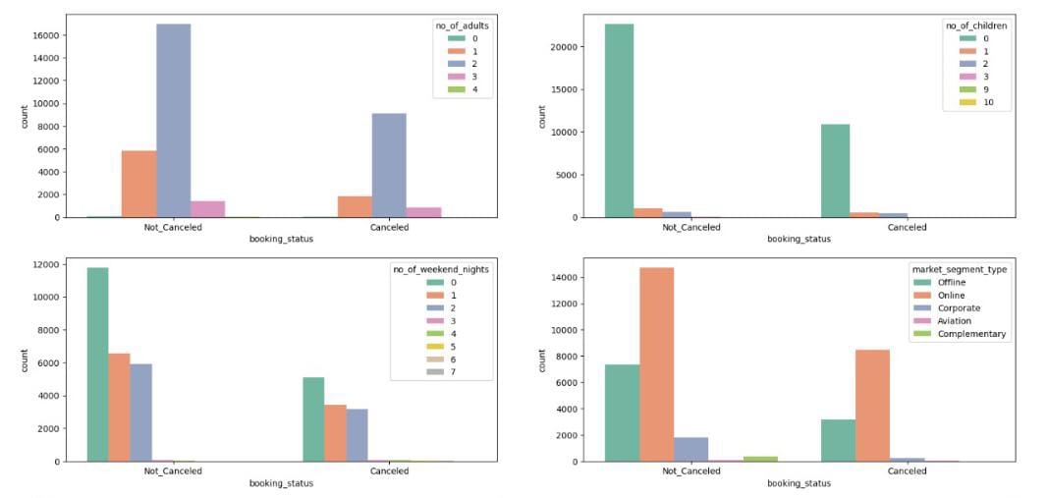
Analysis of Variable based on Booking Status

Slide 13
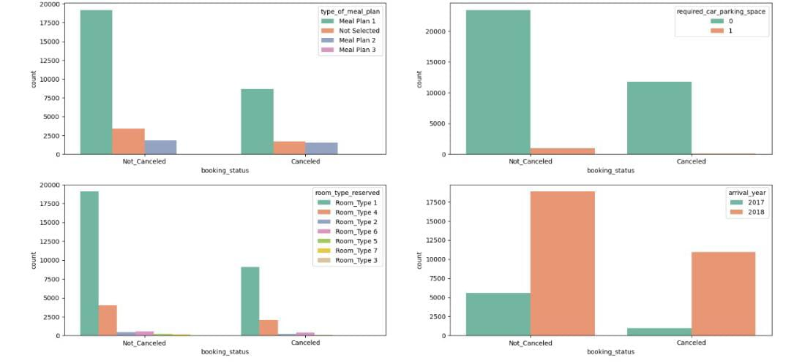

Slide 14
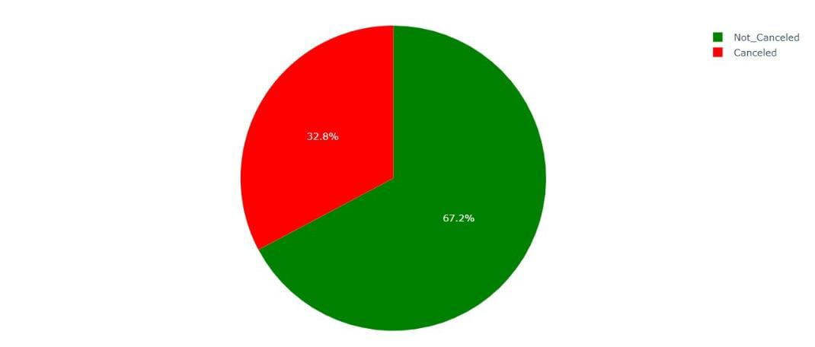
Booking status
32% of the total customers cancels the reservation

Slide 15
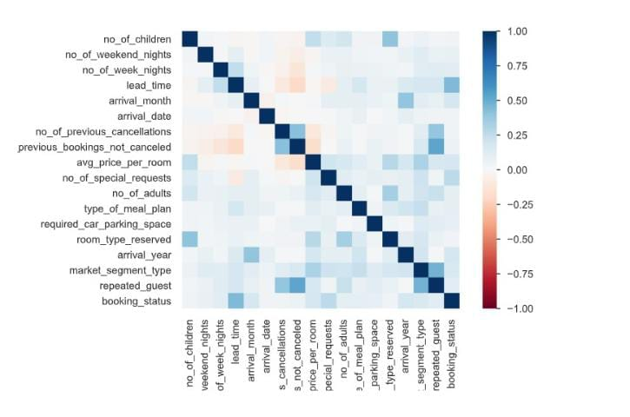
Correlation Matrix

Slide 16
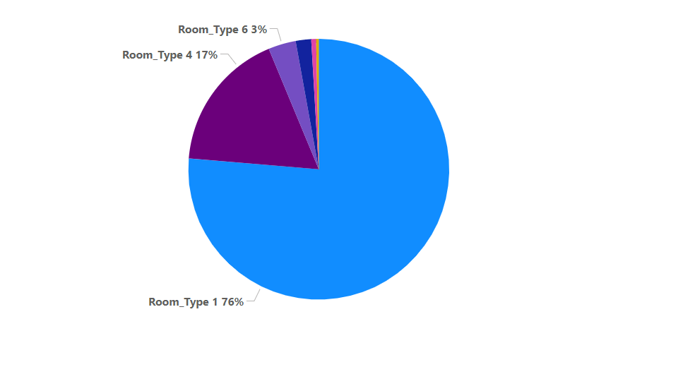
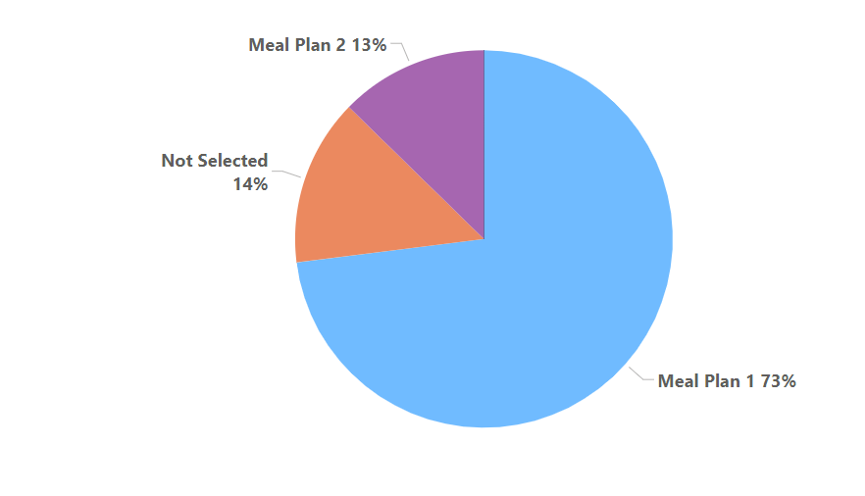
Features leading to cancelation of reservation
Room reservation type
Meal plan type

Slide 17
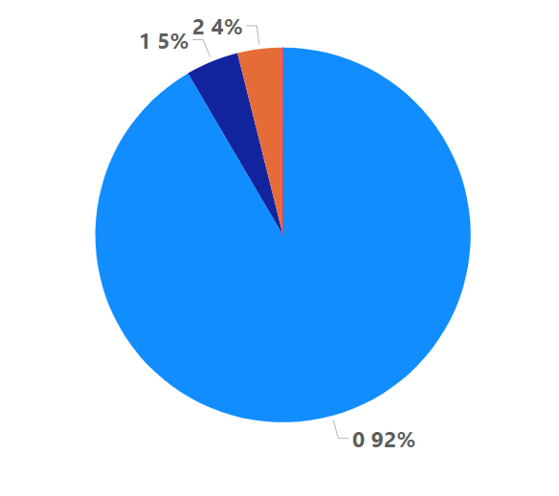
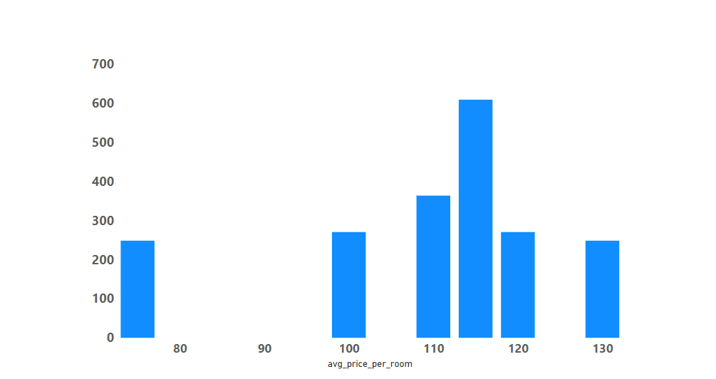
Based on number of children they have
Based on average price for a room

Slide 18
Data partitioning
The entire data consists of 36275 rows and 19 columns
The data has been partitioned in such a way that train data is 80% of the total and test data is 20% of the total data
Number of rows in train data=29020
Number of rows in test data=7255

Slide 19
Algorithms used
Logistic regression
Decision tree
Random forest
Gradient Boosting Method

Slide 20
Logistic regression
Feature selected =
Slope =7.2813
Intercepts =
Accuracy on train data=65%
Accuracy on test data=64%
['type_of_meal_plan', 'market_segment_type', 'no_of_adults', 'no_of_week_nights', 'required_car_parking_space', 'arrival_month', 'avg_price_per_room', 'no_of_special_requests']
[-0.0270703 , -0.76676554, -0.24550667, -0.13578124, 1.40714271, -0.0174829 , -0.01037427, 1.26615146]

Slide 21
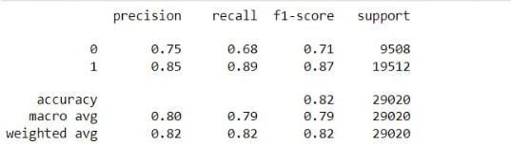
Decision Tree
Hyperparameters used:
criterion=Gini,
min_samples_leaves=50,
min_sample_split=100 ,
max_dept=10
Accuracy on train data:82%
Accuracy on test data:83%

Slide 22
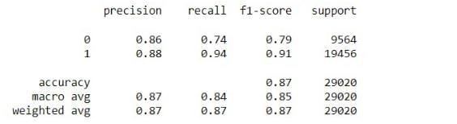
Random forest
Hyperparameters used:
n_estimators=25,
criterion=Gini,
min_sample_leave=5 ,
min_sample_split=10,
max_depth=15
Accuracy on train data=87%
Accuracy on test data=85%

Slide 23
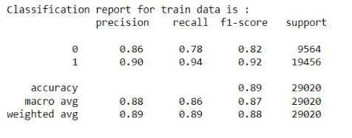
Gradient Boosting Method
Model Parameters:
n_estimators=10
Max_depth=6
Learning_rate=0.9
Min_samples_leaf=100
Min_sample_split=50
Accuracy of train data=89%
Accuracy of test data=88%

Slide 24
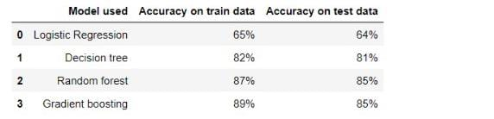
Model summary report

Slide 25
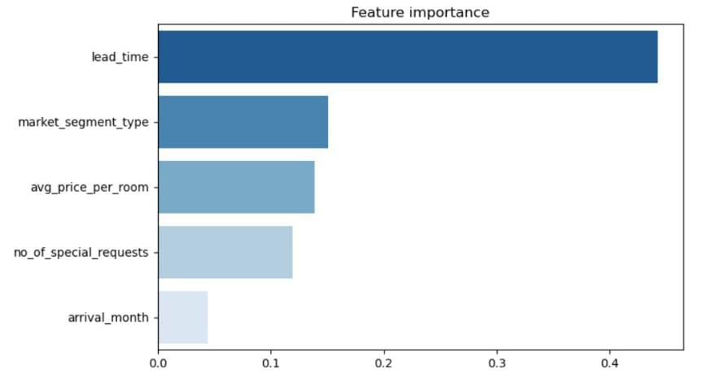
Important features

Slide 26
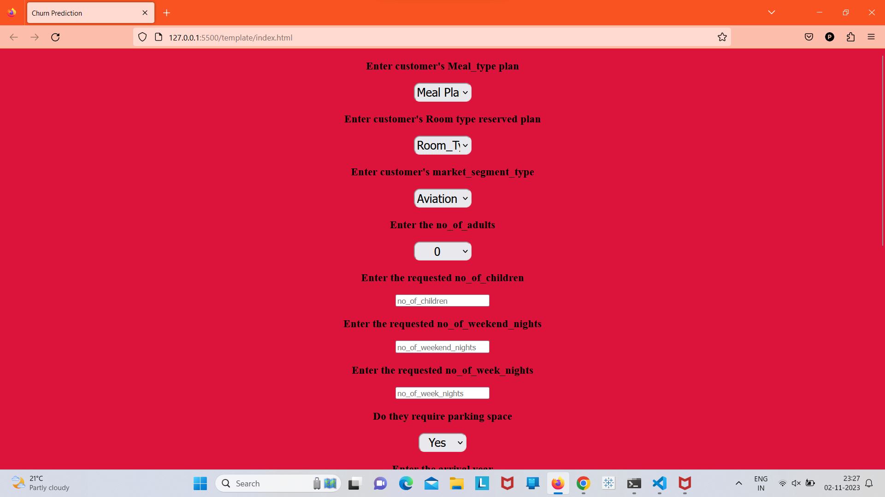
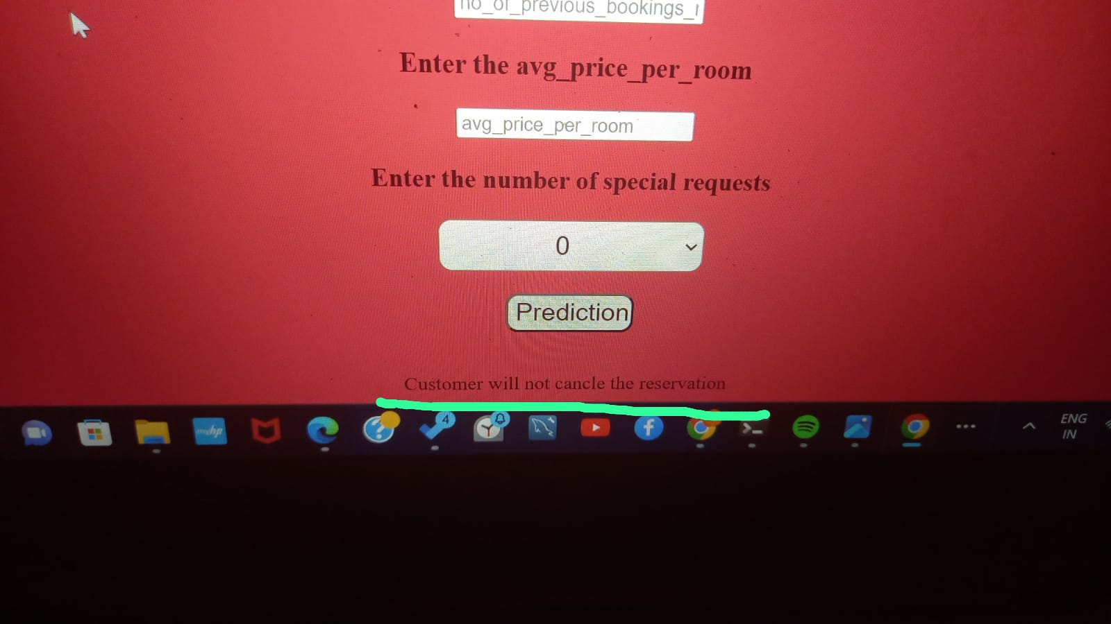
Deployment

Slide 27
Interpretation
15% of the total customers are unstable customers based on their previous record
54% of the trusted customers are customers who are potential to spend more money
Meal_plan 1 and 2 have the highest cancelation rate
Room_type 1 and 4 have the highest cancelation rate
June,july ,aug ,sept,oct have the highest number of canceled booking record
7% people of the restaurant are not loyal and need to be payed attention when they come for booking request
Reservation of hotel with the average cost of the room 65 is best seller
Customers who book rooms that are free of cost are have very less chances to cancelation¶
There are 62.29% reservations in 2018 and 85.24% of reservation in 2017 hence the reservation has decreased by 23%

Slide 28
Suggessions
Strategy with respect to room price needs to be planned to increase the revenue
The restaurant has a high crowd to rich customers hence more facility can be provided inorder to earn more revenue
Do not give Room_type 1 and Room_type 5 for repeated customers or make changes in the rooms
Need to either update or change meal_plan 1 and meal_plan2
Bring more offers and plans for the month of June,July ,august , September and October

Slide 29
THANK YOU.

